Slide 1



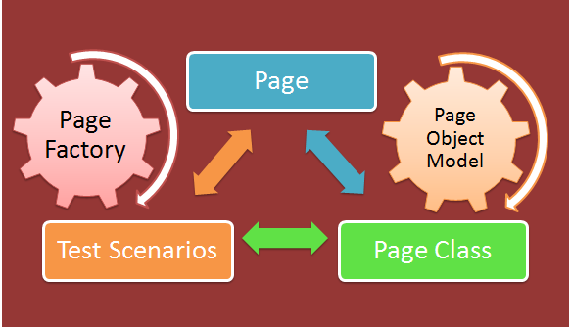
WebDriver Design Patterns
Page Object Pattern, AAA Pattern,
QA
Automation
SoftUni Team
Technical Trainers
Software University
http://softuni.bg

Slide 2

Table of Contents
C# Attributes
NUnit Attributes
SetUp
TearDown
Page Object Model
Page Map and Page Asserter
AAA Testing Pattern

Slide 3
Have a Question?
sli.do #QA-Automation

Slide 4
What is Attribute?
Allows you to attach declarative information to any type
Accessed at compile-time
Accessed runtime through the metadata
[TestFixture]
public class LoginToSoftUniTests
{
[Test]
[Author("BestQA")]
public void LoginWithValidData() {}
}
You can have multiple attributes on single unit

Slide 5
NUnit Attributes
Property attribute
Author attribute
Other useful attributes can be find in documentation
[Test, Property("Priority", 2)]
public void NavigateToRegistrationPage() {}
[Author ("Ventsislav Ivanov")]
public void NavigateToRegistrationPage() {}

Slide 6

Problem: NUnit Test
Add two more negative tests for registration
Refactor your code
Add SetUp method
Add TearDown method
Split navigation test from main test

Slide 7
Solution: NUnit Test
[TestFixture]
public class RegisterInDemoQA
{
public IWebDriver driver;
[SetUp]
public void Init()
{ this.driver = new ChromeDriver(); }
[TearDown]
public void CleanUp()
{ this.driver.Quit(); }
}
SetUp methods will be execute before every test
TearDown methods will be execute after every test

Slide 8
Page Object Pattern
Setup and First Test

Slide 9
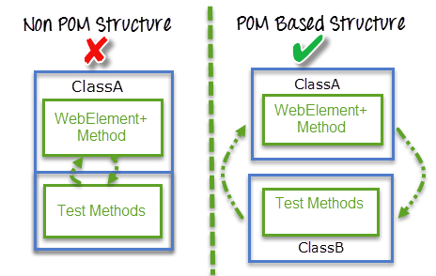
What is Page Object Model (POM)
Models areas of an UI as objects
Represent a logical relationship between the pages
Page Object class is responsible to find the web elements
Methods which perform operations on those web elements.

Slide 10
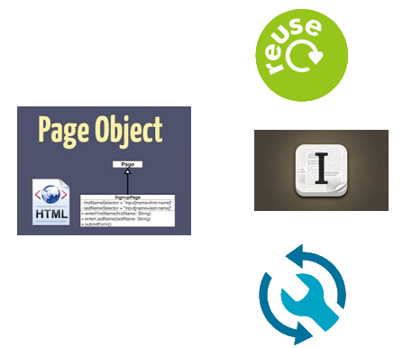
Advantages of Page Object Model
Easy to maintain
Easy readability of scripts
Reduce or eliminate duplicity
Re-usability of code
Reliability

Slide 11
Selenium Page Object Model
FindsBy attribute is write for every element property in page
FindsBy using By strategy
Using variable will be used in By strategy like parameter
[FindsBy(How = How.ClassName, Using = "entry-title")]
public IWebElement Title { get; set; }
FindsBy can accept tagName, partialLinkText, name, linkText, id, CSS, className, XPath as attributes.

Slide 12
Elements Initialization
When you initialize a page all elements are null
Use build-in PageFactory to initialize elements
Elements are initialize once and if they change you MUST initialize all of them again
PageFactory.InitElements(this.driver, homePage);
Selenium static class
Static method, which initialize all elements at once
Method parameters are always driver and page

Slide 13

Problem: Implement Page Object Model
Add new classes HomePage
Add new classes RegistrationPage
Add new class BasePage
Base page will have only duplicate code from other pages

Slide 14
Solution: Implement Page Object Model
public void NavigateToRegistrationPage()
{
var homePage = new HomePage(this.driver);
PageFactory.InitElements(this.driver, homePage);
homePage.NavigateTo();
homePage.RegirstratonButton.Click();
var regPage = new RegistrationPage(this.driver);
PageFactory.InitElements(this.driver, regPage);
Assert.AreEqual("Registration", regPage.Header.Text);
}

Slide 15
Custom Page Object Model
When you need real time element selection
With custom POM you can have collection of elements
public IWebElement FirstName
{
get
{ return this.Driver.FindElement(By.Id("name_3_firstname")); }
}
public IList<IWebElement> Hobbys {}

Slide 16
Custom Page Object Model
When you need real time element selection
With custom POM you can have collection of elements
public IWebElement FirstName
{
get
{ return this.Driver.FindElement(By.Id("name_3_firstname")); }
}
public IList<IWebElement> Hobbys {}

Slide 17

Page, Map and Asserter
Different Elements in Pages

Slide 18

Pagе Elements
Every page have three logical different object:
Page basic methods
Page map
Page asserter

Slide 19
Page Basic and Page Map
Partial class for page logic and map
The class name and generic-type parameters must match on all partial-type definitions
All partial-type definitions meant to be parts of the same type
public partial class RegistrationPage
To split a class definition, use the partial keyword modifier

Slide 20
Page Asserter
Page asserter collect all asserts we need for this page
Can be implement like extension methods
Extension methods are brought into scope at the namespace level
public static void AssertRegistrationPageIsOpen
(this RegistrationPage page, string text)
{
Assert.AreEqual(text, page.Header.Text);
}

Slide 21
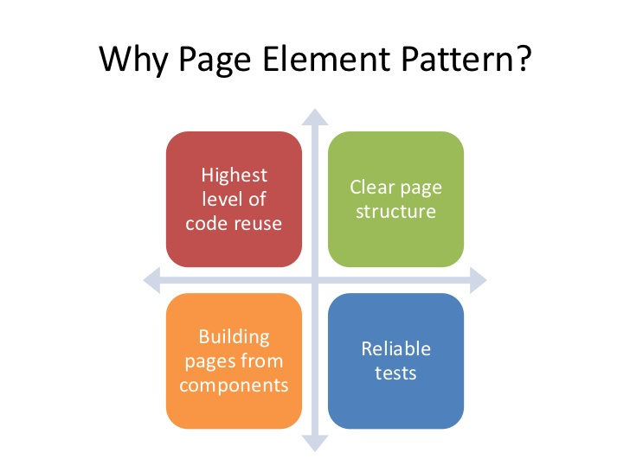
Problem: Separate Page Elements
Create classes for map and asserter for each page
Separate page elements in new classes
Write new test
Move duplicate logic to page

Slide 22
Solution: Separate Page Elements
public partial class RegistrationPage : BasePage
{
public RegistrationPage(IWebDriver driver)
:base(driver) { }
public void NavigateTo()
{
this.Driver
.Navigate()
.GoToUrl("http://demoqa.com/registration/");
}
}

Slide 23
Solution: Separate Page Elements Map
public partial class RegistrationPage
{
public IWebElement Title
{
get { return this.Driver.FindElement(By.TagName("title"));}
}
public IWebElement UserName
{
get { return this.Driver.FindElement(By.Id("username"));}
}
//TODO: Add other elements need for test
}

Slide 24
Solution: Separate Page Elements Asserter
public static class RegistrationPageAsserter
{
public static void AssesrtSuccessMessage
(this RegistrationPage page, string text)
{
Assert.IsTrue(page.SuccessMessage.Displayed);
Assert.AreEqual(text, page.SuccessMessage.Text);
}
}

Slide 25

AAA Pattern
Arrange, Act, Assert

Slide 26
What is AAA Testing Pattern
Organize and clarify test code by breaking down a test case into the following functional sections:
The Arrange section of a unit test initializes objects and sets the value of the data that is passed to the test case
The Act section invokes the test case with the arranged parameters
The Assert section verifies the test case behaves as expected

Slide 27
Problem: Implement AAA Pattern
Refactor all tests to AAA pattern
public void NavigateToRegistrationPage()
{
var homePage = new HomePage(this.driver);
var regPage = new RegistrationPage(this.driver);
homePage.NavigateTo();
homePage.RegirstratonButton.Click();
regPage.AssertRegistrationPageIsOpen("Registration");
}

Slide 28

Models
Models of Test Data

Slide 29
What is Test Data?
Test data is the documented data that is basically used to test the software program
Test data needs to be precise and exhaustive to uncover the defects
Recognize application boundary cases to organize data set that will cover lower as well as upper boundary conditions

Slide 30
Data Types
Correct data set
Ensure that an application is responding as per the requirement or not and to know that the data is correctly saved in a database/file or not
Incorrect data set
Confirm application behavior for negative values, alphanumeric string inputs

Slide 31

Problem: Implement Models For Data
Create new class for data modeling
Add properties for necessary fields in registration form
Add data modeling to Arrange part of tests

Slide 32
Solution: Implement Models For Data
public class RegistrationUser
{
private string firstName;
private List<bool> martialStatus;
//TODO: Add other fields
//TODO: Add constructor
public string FirstName
{
get { return this.firstName; }
set { this.firstName = value; }
}
}

Slide 33

Summary
Attributes
Page Object Model
Build-in POM
Custom POM
AAA testing pattern
Models

Slide 34








Selenium WebDriver Design Patterns
https://www.w3schools.com/xml/xpath_axes.asp

Slide 35
License
This course (slides, examples, demos, videos, homework, etc.) is licensed under the "Creative Commons Attribution-NonCommercial-ShareAlike 4.0 International" license

Slide 36





Free Trainings @ Software University
Software University Foundation – softuni.org
Software University – High-Quality Education, Profession and Job for Software Developers
softuni.bg
Software University @ Facebook
facebook.com/SoftwareUniversity
Software University @ YouTube
youtube.com/SoftwareUniversity
Software University Forums – forum.softuni.bg

